Slide 1
Spotify Product Dissection & PostgreSQL Schema Design
Spotify Database Design Prepared by: Swapnil Nicolson Dadel

Slide 2
Agenda
• Industry Overview • Why Spotify • Product Dissection • Core Features • Problems & Solutions • Database Schema • ER Diagram • SQL Analysis • Conclusion

Slide 3
Industry Overview
• Growth of music streaming • Shift from downloads to cloud streaming • Data-driven personalization

Slide 4

Why Spotify?
• Founded in 2006 • Global streaming leader • Free & Premium plans • Millions of users worldwide

Slide 5
Product Dissection
• Music streaming • Podcasts • Personalized recommendations • Playlists

Slide 6
Core Features
• Music Streaming • Playlist Management • Recommendations • Subscription Plans

Slide 7
Real-World Problems
• Access to music • Music discovery • Playlist organization • Personalized listening

Slide 8
Spotify Solutions
• Cloud streaming • AI recommendations • Smart playlists • Premium features

Slide 9
Why PostgreSQL?
• Relational database • ACID properties • Constraints • Indexes

Slide 10
Database Schema
Users Artists Albums Genres Tracks Playlists Playlist_Tracks Listening_History Subscription_Plans Subscriptions Recommendations

Slide 11
Schema Design Rationale
• 3NF • Reduced redundancy • PK & FK • Data integrity

Slide 12
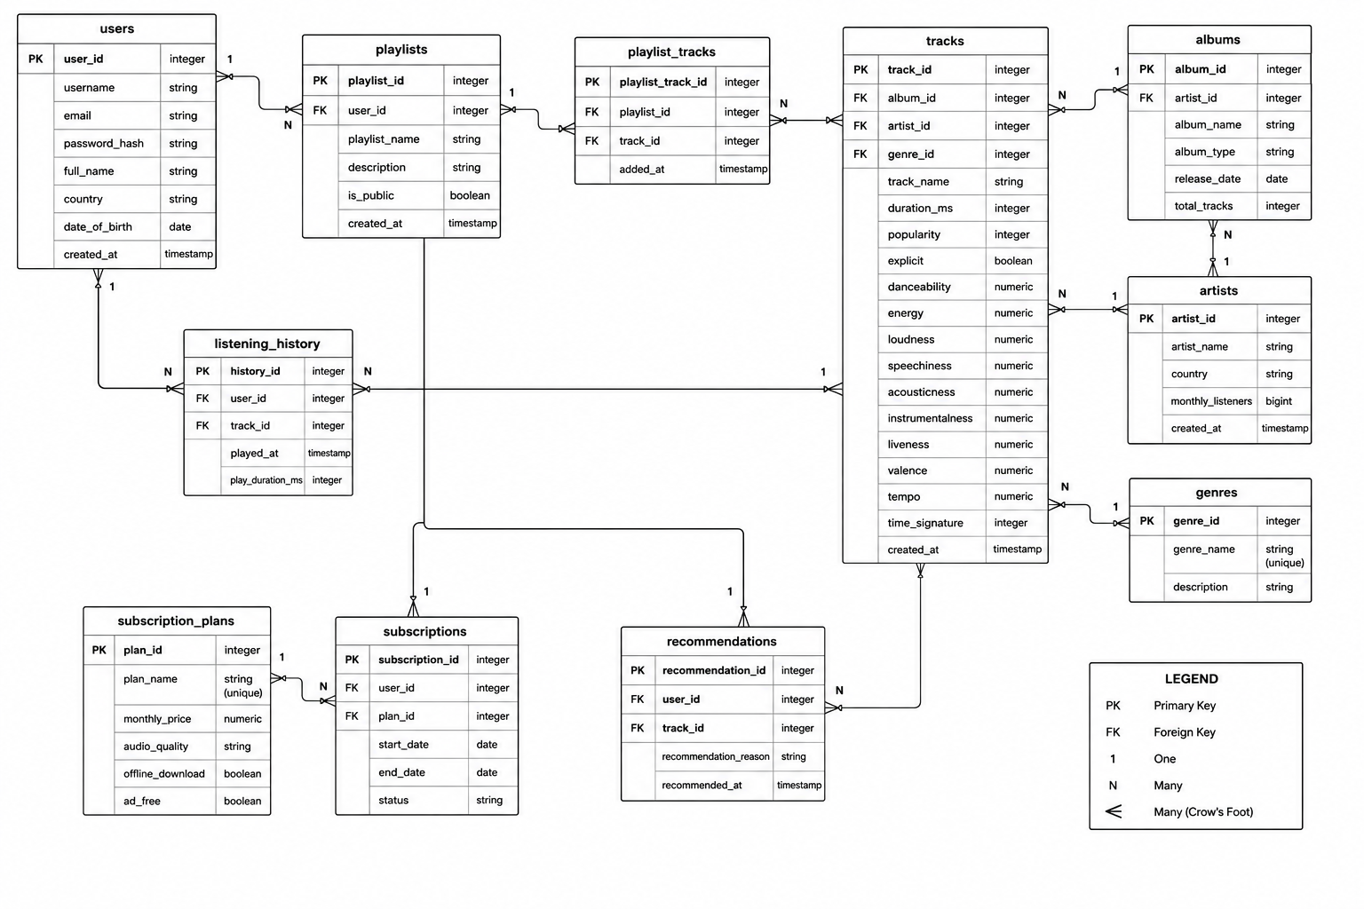

Slide 13
SQL Workflow
Dataset → Staging Table → EDA → Business Insights → Normalized Schema

Slide 14
EDA
• Data Familiarization • Data Quality • Genre Analysis • Audio Features

Slide 15
Business Insights
• Popular artists • Popular genres • Duration analysis • Explicit songs

Slide 16
Advanced PostgreSQL
• CTE • Window Functions • ROW_NUMBER • NTILE • Indexes

Slide 17
Key Learnings
• Schema Design • Normalization • Query Optimization • Analytical SQL

Slide 18
Conclusion
• Completed product dissection • Designed PostgreSQL schema • Generated insights

Slide 19
Thank You

